Slide 1
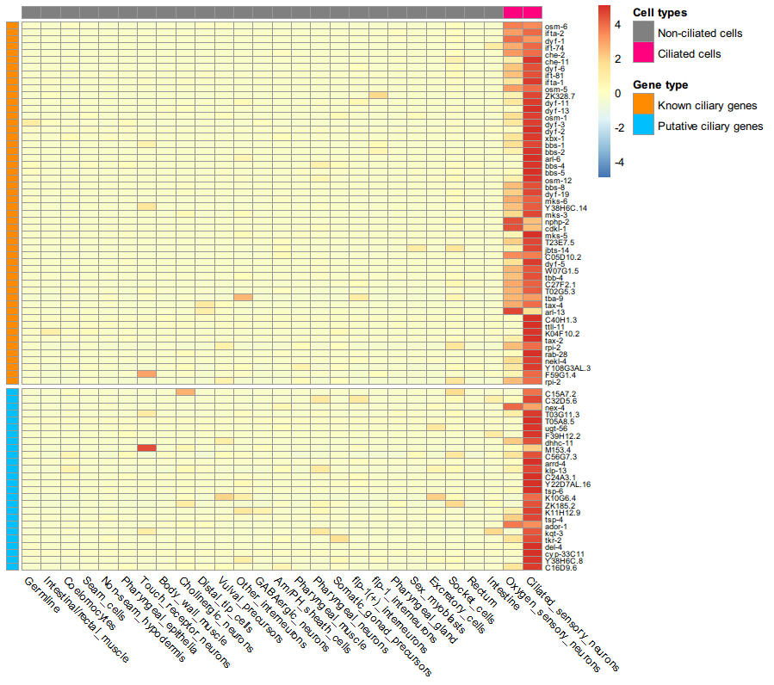
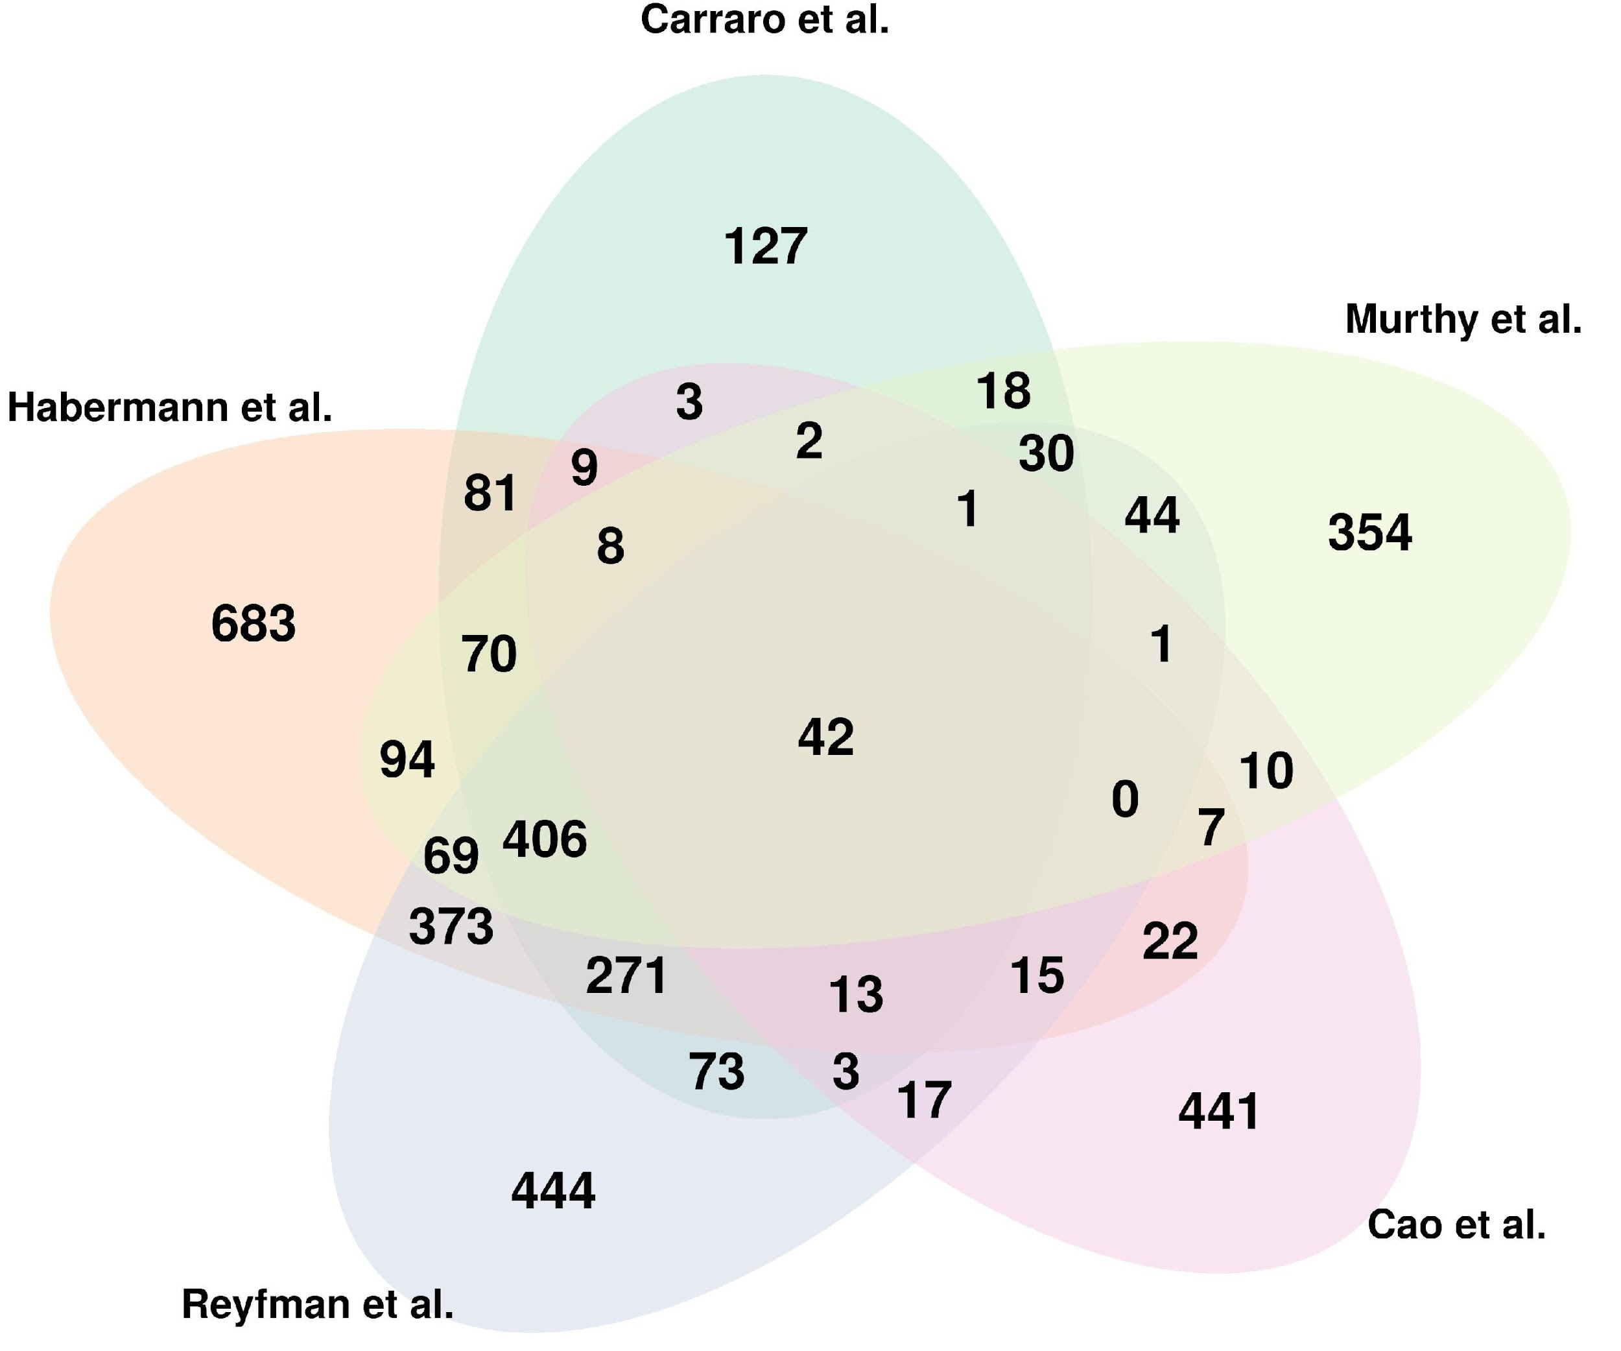
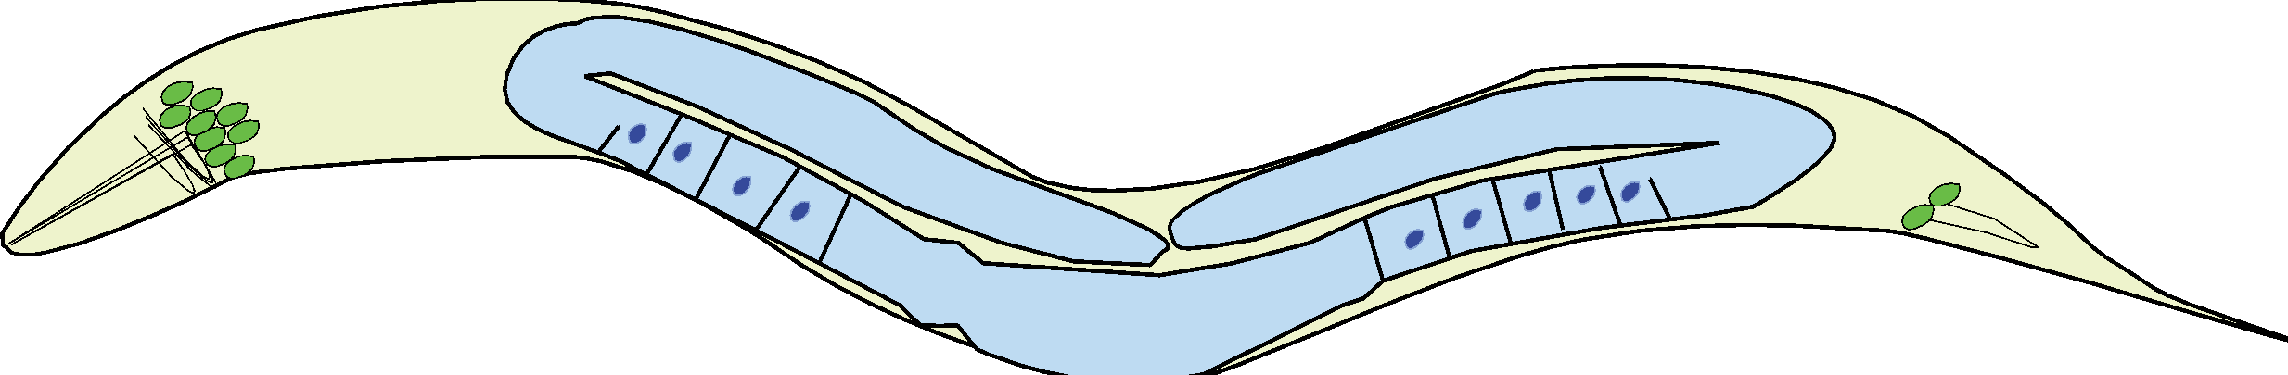








A
B
IFT and BBSome components
TZ components
Ciliary genes
Ciliary candidate genes
Head
(Amphid ciliated cells)
Tail
(Phasmid ciiliated cells)
C
Ciliary Candidate Genes
IFT
Genes
TZ
Genes
Ciliary Genes
CLUAP1
TRAF3IP
WDR19
IFT122
IFT140
IFT172
IFT22
IFT80
IFT81
FT88
BBIP1
DYNC2H1
DYNC2LI1
CC2D2A
TMEM67
TMEM231
TCTN1
NPHP1
TOGARAM1
RP1
DOC2A
GAS8
DCDC2B
NEK10
OSCP1
MAK
SAXO2
KIF19
CROCC
CYB561
FAIM
FHAD1
HIPK1
LMLN
MAPK10
NWD1
STK33
FAM102A
BAIAP3
SPA17
WDR54
ZC2HC1A
tmem-145p::gfp
Cell Soma
Cell Soma
zchc-1ap::gfp
Cell Soma
Cell Soma
wdr-54p::gfp
Cell Soma
Cell Soma

Slide 2
A
Cell Types
Negative Genes
Non-ciliated cells
B
Gold Standart
Known ciliary genes
Gene Type
Ciliated cells
506
Primary cilia
(C. elegans only)
Putative ciliary genes
957
119
0
Motile cilia
(Lung +Trachea)
202
0
0
156
8
0
40
0
23
WDR38
TMEM190
SPATA17
ZC2HC1A
ARMC3
C1ORF87
C4ORF47
C6ORF118
TMEM232
CCDC17
CCDC17
CCDC57
FAM81B
FAM166B
ZC2HC1A
FAM227A
NEK5
RIBC2
TSPAN1
UBXN11
WDR93
ZNF273
VWA3B
OMG
MAK3K19
LRRC71
LRRC46
LRRIQ1
KCNE1
HAGHL
4
ZNF474
TMEM145
TTLL11
BAIAP3
CD151
UPP1
CDKL1
CDC34
OTX2
PAX6
WDR31
KIF28B
HECA
STOM
PDE10A
NIM1K
TTC39C
FAAH
FAXC
PRCP
WDR54
DCDC2B
MAPK10
OSCP1
C
Head
(Amphid ciliated cells)
Tail
(Phasmid ciiliated cells)
Head
(Amphid ciliated cells)
Tail
(Phasmid ciiliated cells)
tmem-145p::gfp
Cell Soma
Cell Soma
wdr-54p::gfp
Cell Soma
Cell Soma
zchc-1ap::gfp
Cell Soma
Cell Soma

